Slide 1
Superior Solar Conjunction Planning
May 8, 2014
Dan Ossing
STEREO Mission Operations Manager
(240) 228-8319

Slide 2
Agenda
HGA Feed Temperature Constraint
Schedule
Key Dates

Slide 3
HGA Feed Temperature Constraint
HGA feed will increase in temperature beyond acceptable limits with SPE angle below 6.5 degrees.
If SPE angle exceeded, damage to the feed assembly will render the HGA unusable.
Thermal modeling and analysis in progress
Results due by the end of May
Not done before launch as the mission was only two years.
Off point HGA to prevent excessive heating
Keep feed temperature below 125 deg C
Temperature sensor limit = 136 deg C
Damage starts @ 150 deg C (adhesives)
AHEAD – September 2014 through December 2015
BEHIND – November 2014 through January 2016
At this time, anticipating instruments will off for these durations due to low data rates
Investigating HGA side lobe for low data rate communications
Testing on May 10th (AHEAD) and May 17th (BEHIND)

Slide 4
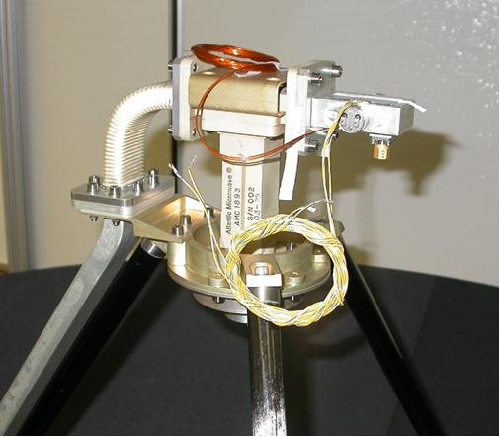
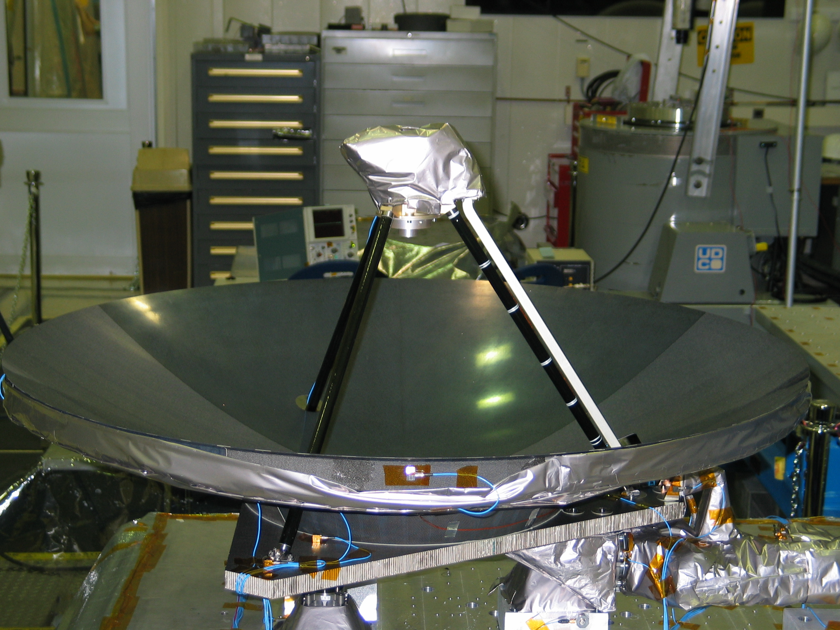
HGA Feed Assembly

Slide 5
STEREO AHEAD Timeline Schedule - DRAFT
Reviews
MOps
Readiness
Test on S/C
Post Solar
Conjunction
Assessment
FP
Readiness
Solar Conjunction
Readiness
Months
5
6
7
8
9
10
11
12
2015
2
3
4
5
6
7
8
9
10
11
12
2016
2
Date
SPE (deg)
9/2
6.8
9/7
6.6
3/24
2
5/20
0
7/7
2
12/9
6.6
12/15
6.8
Load C&DH FSW 3.2.4
HGA on Main Lobe
Load Parameters
Solar Conjunction
No Communications
(105 days)
Load MOps Macros & FP
& Set EA Bypass
SSR Playback &
Reconfiguration &
S/C Checkout
Activities
HGA Calibration
Test on S/C
HGA on Side Lobe
Instrument Power on
& Recommissioning
Instrument Power Down
& SSR Reconfiguration
HGA Calibration
Rotate
Rehearse w/ DSN
S/C
Config
Rotate @ 5 deg/min
HCLT Reset
Every 3 days
(105 days)
3 axis &
Standby Mode
(155 days)
3 axis
& Op Mode
3 axis &
Op Mode
3 axis & Standby Mode
(198 days)
3 axis &
Op Mode
HGA Low
Rates
RF
HGA
Nominal
Rates
HGA
Nominal
Rates
HGA Auto Track Low Data Rates (198 days)
No
Communications
(105 days)
HGA Auto Track Low Data Rates (155 days)
HGA
Nominal
Rates
70m, 3 hrs
No
Coverage
(105 days)
DSN
Nominal
Tracks
Nominal
Tracks
70m, Daily 3 hrs (198 days)
70m, Daily
3 hrs (155 days)
Nominal
Tracks
All Instr. off
Nominal
Science
Instruments
Nominal
Science
Nominal
Science
Instruments Off (~469 days)

Slide 6
STEREO BEHIND Timeline Schedule - DRAFT
Reviews
MOps
Readiness
Test on S/C
Post Solar
Conjunction
Assessment
FP
Readiness
Solar Conjunction
Readiness
Months
5
6
7
8
9
10
11
12
2015
2
3
4
5
6
7
8
9
10
11
12
2016
2
Date
SPE (deg)
11/12
7.2
11/19
6.8
1/22
2
2/19
0
3/23
2
9/24
2
1/12
6.8
1/18
7.2
Load C&DH FSW 3.2.4
Solar Conjunction
No Communications
(60 days)
HGA on Main Lobe
Load Parameters
Load MOps Macros & FP
& Set EA Bypass
SSR Playback &
Reconfiguration &
S/C Checkout
Activities
HGA Calibration
HGA on Side Lobe
Instrument Power on
& Recommissioning
Test on S/C
Instrument Power Down
& SSR Reconfiguration
Rehearse w/ DSN
HGA Calibration
Rotate
Rotate @
5 deg/min
HCLT Reset
Every 3 days
(60 days)
S/C
Config
3 axis & Op Mode
3 axis &
Op Mode
3 axis &
Standby
Mode
(64 days)
3 axis &
Standby Mode
(295 days)
3 axis &
Op Mode
HGA Low
Rates
HGA Auto
Track Low
Data Rates
(64 days)
No
Comm
(60 days)
RF
HGA Nominal Rates
HGA
Nominal
Rates
HGA Auto Track Low Data Rates (295 days)
HGA
Nominal
Rates
70m, 3 hrs
70m
Daily 3 hrs
(64 days)
No
Coverage
(60 days)
DSN
Nominal Tracks
Nominal
Tracks
70m, Daily 3 hrs (295 days)
Nominal
Tracks
All Instr. off
Nominal
Science
Instruments
Nominal Science
Nominal
Science
Instruments Off (~432 days)

Slide 7
Key Dates
Event | AHEAD | BEHIND
HGA side lobe test | 5/10/14 | 5/17/14
LGA calibration test | 6/8/14 | 5/23/14
Load C&DH 3.2.4 FSW to EEPROM Copy 1 | 5/20/14 | 5/20/14
Load G&C and C&DH parameters to EEPROM | 5/28/14 | 5/28/14
Load MOps macros & FP releases to EEPROM | 6/10/14 | 6/10/14
MOps Readiness for S/C Testing Review | 6/19/14 | 9/18/14
S/C Testing – Instruments off/on | 7/7 thru 7/15/14 | 9/29 thru 10/6/14
HGA Calibration – Pre-conjunction | 7/23/14 | 7/23/14
Load C&DH 3.2.4 FSW to EEPROM Copy 2 | 7/28/14 | 7/28/14
Solar Conjunction Readiness Review | 8/14/14 | 10/23/14
Instrument Power Down & SSR Reconfiguration | 9/2/14 | 11/14/14
Rehearse with DSN | 9/5/14 | 11/16/14
HGA on Side Lobe | 9/7/14 | 11/19/14
Superior Solar Conjunction | 3/24 thru 7/7/15 | 1/22 thru 3/23/15
HGA on Main Lobe | 12/9/15 | 1/12/16
SSR Playback & Reconfiguration & S/C Checkout | 12/10/15 | 1/13/16
Instrument Power on & Recommissioning | 12/15/15 | 1/18/16
HGA Calibration – Post-conjunction | 1/27/16 | 1/27/16
Post Solar Conjunction Assessment Review | 3/16 | 3/16

Slide 9
Three Laws of STEREO Solar Conjunction
Take all reasonable precautions to keep the observatory safe.
Of course, “reasonable” is subject to interpretation and judgment. We will be guided by the usual risk assessment methodology of weighing both probability and impact, which is, after all, the implicit thinking behind “engineering judgment.”
Return to normal science operations as soon as reasonably possible. In cases where this law conflicts with the First Law, the First Law takes precedence.
There’s that word “reasonably” again. We do not have infinite time and manpower to prepare for conjunction. So, some management judgment is required.
Conduct science operations during conjunction, if reasonably feasible. In cases where this law conflicts with the first two, the first two laws take precedence.
We do not have infinite time and manpower.

